Slide 1
A MORNING SAIL

Slide 2
A MORNING SAIL Read the poem .
Lee goes out in his sailboat
At the very break of day.
Lee lives right down beside the beach.
He starts each day this way.

Slide 3
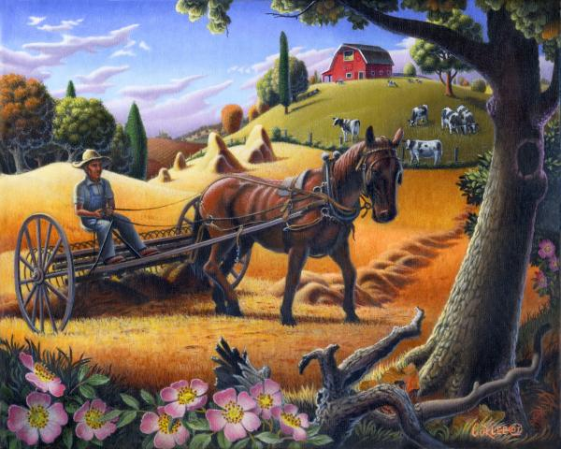
A MORNING SAIL
Lee waves to all the neighbours
He sees along the way-
To fishers with their pails of bait
And farmers raking hay.

Slide 4
A MORNING SAIL
The journey is a brief one.
He pulls into the bay.
But Lee is always happy
When he starts his day this way.

Slide 5
Answer the questions
1.Where does Lee live?
________________________
2.What does Lee go out in?
________________________
3.Who does Lee see each day?
________________________
4.Where does he pull into?
________________________

Slide 6
Look at the picture and make up a poem.

